Slide 1

Project for :
Battle of Happiness
What Makes a Nation Happy?
An exploratory data analysis of the 2019 Happiness Score across 156 countries
Data source: World Happiness Report, 2019

Slide 2
About the Dataset
Each country is scored on overall happiness and six contributing factors
156
9
0
0
Countries ranked
Variables recorded
Missing values
Statistical outliers
The Six Contributing Factors
GDP per capita
Social support
Healthy life expectancy
Economic output per person
Having someone to count on
Years of healthy living
Freedom to make life choices
Generosity
Perceptions of corruption
Autonomy over one's life
Charitable behavior
Trust in government & business
World Happiness Report 2019
2

Slide 3
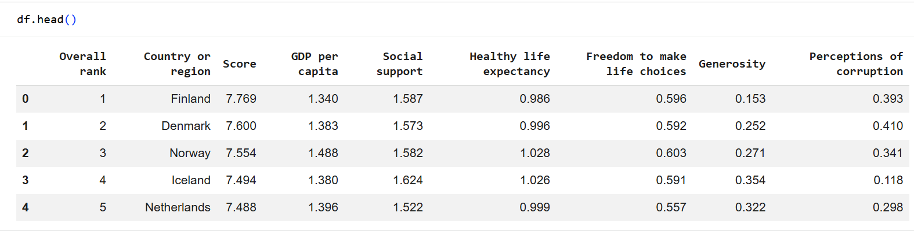
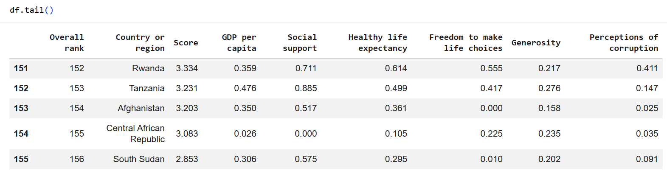
Pre processing
What it does: Displays the first 5 rows of your dataset by default.
Why it’s useful: Gives you a quick preview of the data structure, column names, and sample values.
What it does: Displays the first 5 rows of your dataset by default.
Why it’s useful: Gives you a quick preview of the data structure, column names, and sample values.
World Happiness Report 2019
2

Slide 4
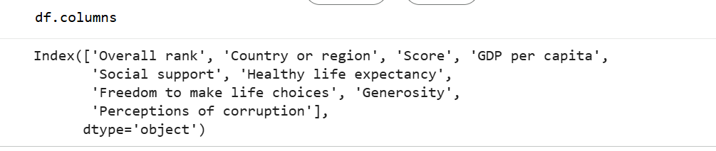
Pre processing
Why we do this:
-To understand the dataset structure
-To reference columns correctly in your code
World Happiness Report 2019
2

Slide 5
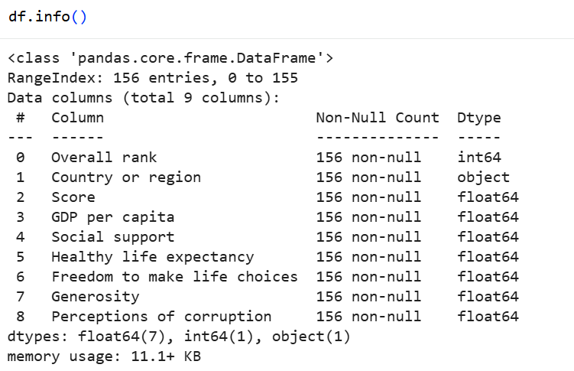
Pre processing
What it does: Prints a concise summary of the DataFrame.
What you get:
Number of rows and columns.
Column names.
Data types (e.g., float64, object).
How many non-null (non-missing) values each column has.
World Happiness Report 2019
2

Slide 6
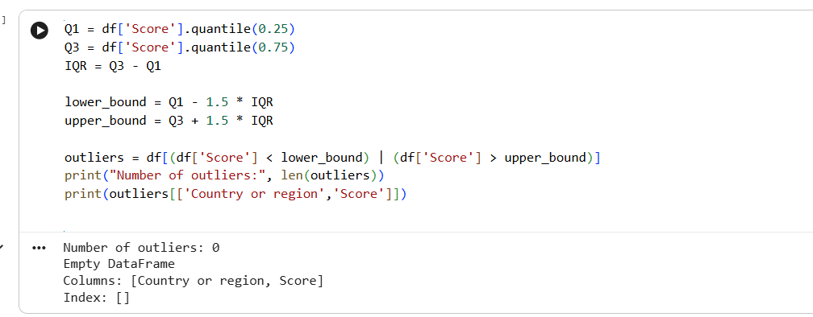
Pre processing
0
Statistical outliers
World Happiness Report 2019
2

Slide 7
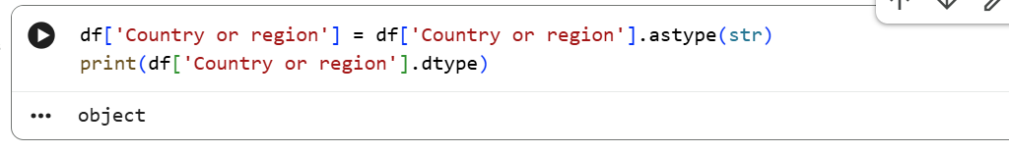
Pre processing
astype(str)
The .astype() method is used to convert the data type of a column.
We are converting the values in Country or region into string type (str) explicitly.
Why do this?
Sometimes when you load a CSV, text columns may be read as object type (a generic type in pandas).
Converting to str ensures that all entries are treated as proper strings.
World Happiness Report 2019
2

Slide 8
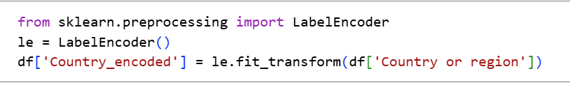
Pre processing
Encoding
What happens to the data:
Each unique country name gets assigned a number (starting from 0).
Example:
Finland → 0
Denmark → 1
Norway → 2
… and so on, until all 156 countries have a code.
A new column Country_encoded is added to the DataFrame with these numeric codes
Why do this?
Machine learning models can’t work directly with text labels like “Finland” or “Denmark.”
Encoding converts them into numbers so models can process them.
World Happiness Report 2019
2

Slide 9
Pre processing
Feature engineering
This divides each country’s overall happiness Score by its GDP per capita.
It gives a measure of happiness efficiency — how much happiness is achieved per unit of economic wealth.
This multiplies two factors: social support and freedom to make life choices.
The result is a combined index showing how strongly social and personal freedom together contribute to well-being.
Here, corruption perception values are inverted.
If corruption perception is high (close to 1), the new value becomes low (close to 0), representing anti-corruption strength.
Essentially, it transforms a negative measure into a positive one.
World Happiness Report 2019
2

Slide 10
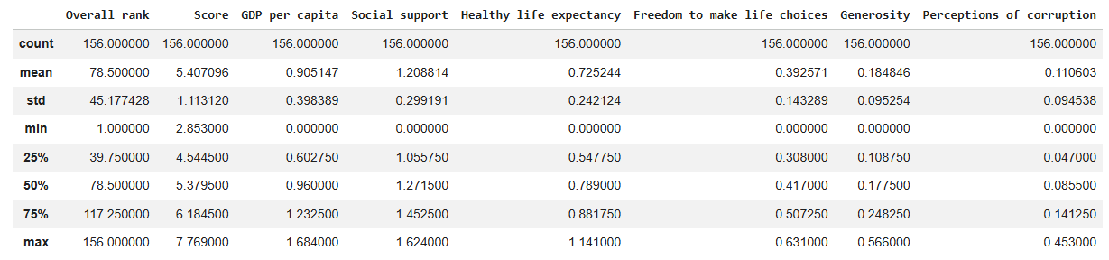
Statistical summery
World Happiness Report 2019
2

Slide 11
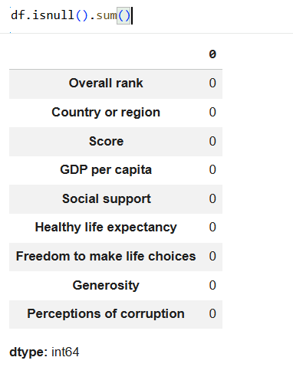

Data exploring + cleaning
Step 1:
Step 2:
0
Dropping duplications :
Missing values
To avoid double counting ,ensure clean statistics, prevent errors in modeling, maintain data integrity
World Happiness Report 2019
2

Slide 12
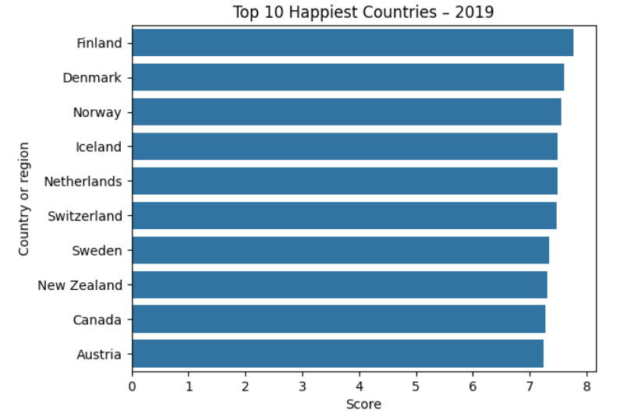
The World's Happiest Countries
Top 10 by Happiness Score
1
Finland
Score: 7.769
#1 for the 2nd year running
Nordic Dominance
4 of the top 5 spots are held by Nordic nations — Finland, Denmark, Norway, and Iceland — pointing to strong social safety nets as a common thread.
World Happiness Report 2019
3

Slide 13
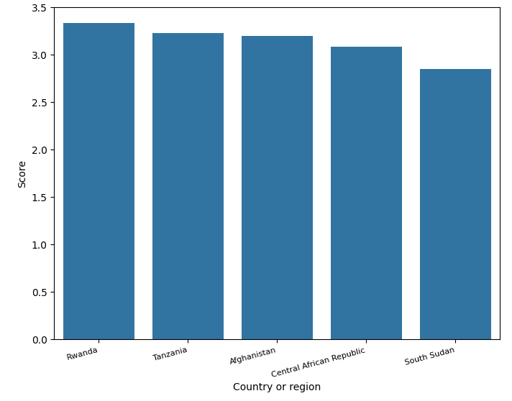
The Other End of the Scale
The 5 lowest-scoring countries
South Sudan ranks last
with a score of 2.853 — nearly 5 points below Finland. Every one of the bottom 5 has experienced recent conflict, displacement, or severe economic hardship.
Distribution Check
Mean score: 5.41 Median score: 5.38 Std. deviation: 1.11 IQR outliers detected: 0
World Happiness Report 2019
4

Slide 14
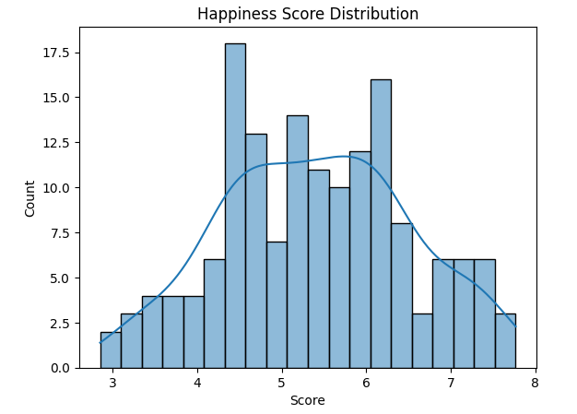
How Are Happiness Scores Spread?
Distribution of Happiness Scores across all 156 countries
Conclusion:
The majority of countries experience moderate happiness, with scores concentrated around the average. Extreme highs and lows are rare, indicating that global happiness is fairly balanced but not universally high.
World Happiness Report 2019
5

Slide 15
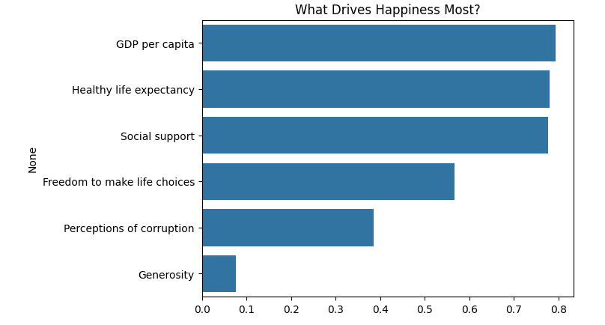
What Drives Happiness Most?
Correlation of each factor with Happiness Score
Key Takeaway
Economic strength, health, and social connection move together with happiness far more than generosity or corruption perceptions.
GDP per capita
is the single strongest predictor of a country's happiness score.
World Happiness Report 2019
6

Slide 16
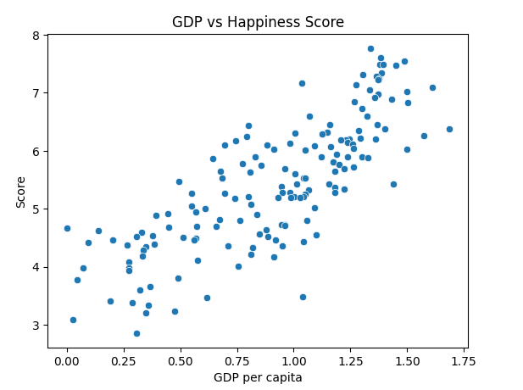
Wealth and Wellbeing
conclusion:
GDP per capita vs. Happiness Score — each dot is one country
As GDP per capita increases, the happiness score also tends to rise.
This suggests that wealthier countries generally report higher levels of wellbeing.
However, the points aren’t perfectly aligned — meaning GDP isn’t the only factor influencing happiness. Other aspects like social support, health, and freedom also play roles.
World Happiness Report 2019
7

Slide 17
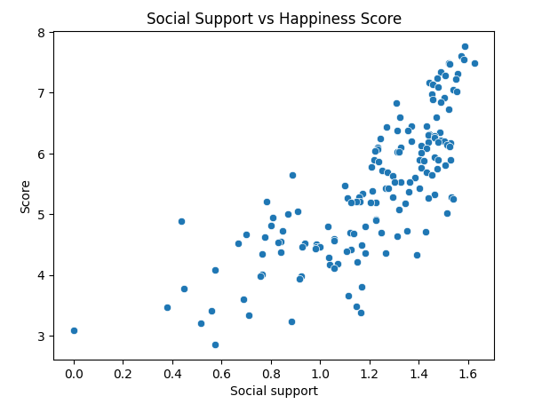
Connections and Community
Social Support vs. Happiness Score — each dot is one country
conclusion:
Countries with higher levels of social support tend to have higher happiness scores.
This means that people who feel supported by friends, family, or community are generally happier and more satisfied with life.
The upward trend suggests that social connections are a key factor in wellbeing, possibly even as important as economic wealth.
World Happiness Report 2019
7

Slide 18
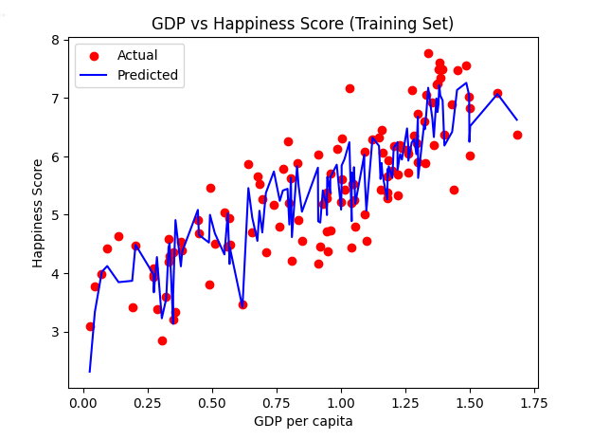
Machine learning model (training set):
World Happiness Report 2019
7

Slide 19
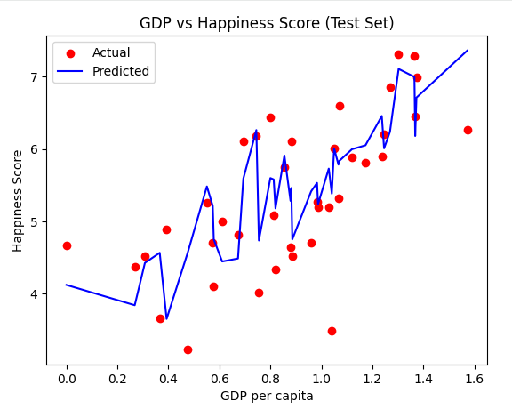
Machine learning model (test set):
Machine learning model conclusion:
The regression model demonstrates a strong positive relationship between GDP per capita and Happiness Score.
In both training and test sets, as GDP per capita increases, happiness scores tend to rise.
The blue prediction line closely follows the red actual points, indicating that the model captures the trend well.
Minor deviations suggest that while GDP is a major contributor to happiness, other factors (like social support and health) also play a role.
Overall, the model generalizes effectively — the test set shows similar patterns to the training set, confirming good predictive performance.
World Happiness Report 2019
7

Slide 20
Key Takeaways
1
Nordic countries lead the world
2
Money matters most, statistically
Finland, Denmark, Norway & Iceland occupy 4 of the top 5 spots, driven by strong social safety nets.
GDP per capita is the strongest single correlate of happiness (r = 0.79), ahead of health and social support.
3
Conflict and instability weigh heaviest
4
Generosity doesn't predict happiness
The five lowest-scoring nations — led by South Sudan — are all marked by recent conflict or crisis.
With r = 0.08, how generous a nation is shows almost no relationship to its happiness score.

Slide 21
Thank You
World Happiness Report 2019 · Exploratory Data Analysis

